Slide 1
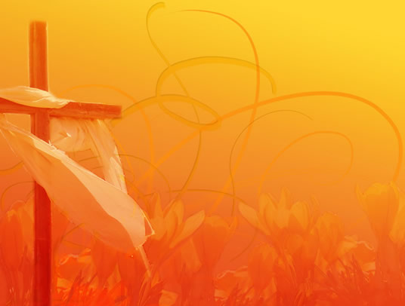
Who Am I
Casting Crowns

Slide 2
Who am I, that the Lord of all the earth
Would care to know my name
Would care to feel my hurt?

Slide 3
Who am I, that the bright and morning star
Would choose to light the way
For my ever wandering heart?

Slide 4
Not because of who I am
But because of what You've done
Not because of what I've done
But because of who You are

Slide 5
I am a flower quickly fading
Here today and gone tomorrow
A wave tossed in the ocean
A vapor in the wind

Slide 6
Still You hear me when I'm calling
Lord, You catch me when I'm falling
And You've told me who I am
I am Yours

Slide 7
Who am I, that the eyes that see my sin
Would look on me with love
And watch me rise again?

Slide 8
Who am I, that the voice that calmed the sea
Would call out through the rain
And calm the storm in me?

Slide 9
Not because of who I am
But because of what you've done
Not because of what I've done
But because of who you are

Slide 10
I am a flower quickly fading
Here today and gone tomorrow
A wave tossed in the ocean
A vapor in the wind

Slide 11
Still You hear me when I'm calling
Lord, You catch me when I'm falling
And You've told me who I am
I am Yours

