Slide 1
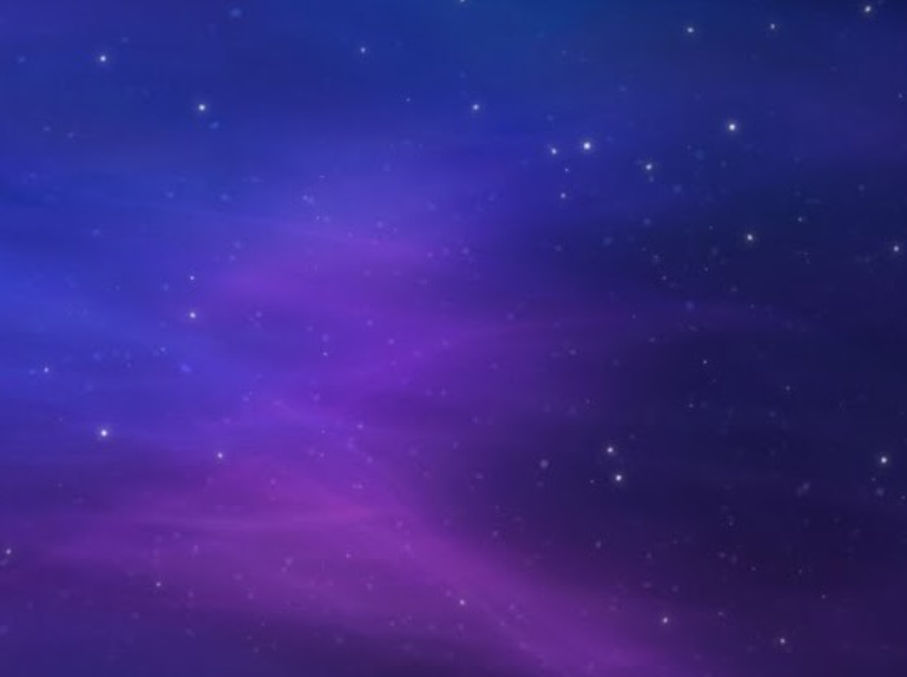
THE FIRST NOEL

Slide 2
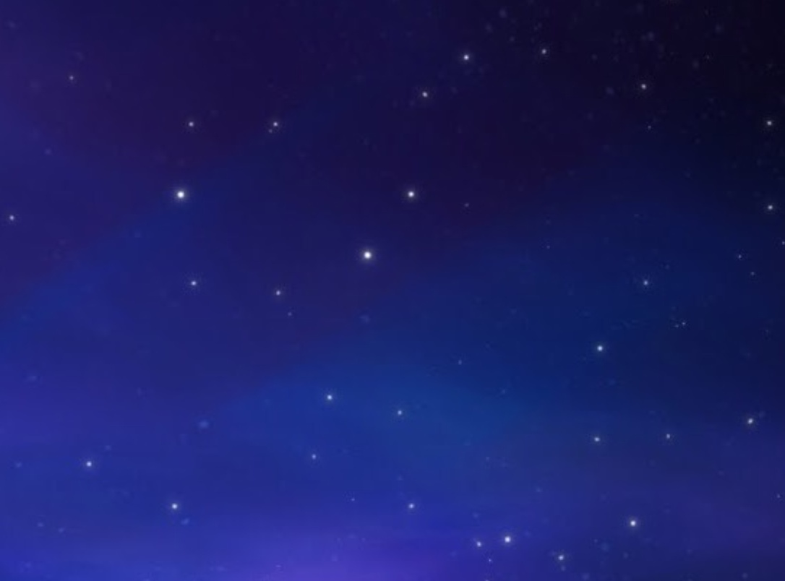
The First Noel, the Angels did say, was to certain poor shepherds, in fields as they lay

Slide 3
In fields where they lay keeping their sheep,
On a cold winter’s night that was so deep.

Slide 4
Noel, Noel, Noel, Noel,
Born is the King of Israel!

Slide 5
They looked up and saw a star,
Shining in the East beyond them far.

Slide 6
And to the Earth,
It gave great light
And so it continued, both day and night

Slide 7
Noel, Noel, Noel, Noel,
Born is the King of Israel!

Slide 8
Then entered in,
Those wise men three,
Fall reverently, upon their knees

Slide 9
And offered there,
In His Presence,
Their gold, and myrrh, and fran-kincense,

Slide 10
Noel, Noel, Noel, Noel,
Born is the KING of Israel!

