Slide 1
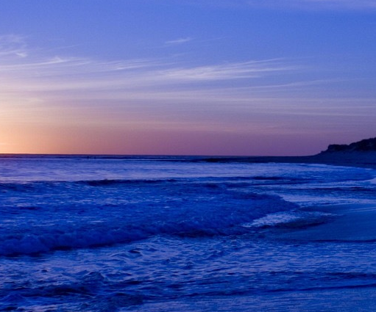
Oceans
-Where Feet May Fail
深海—我或会跌倒的地方

Slide 2
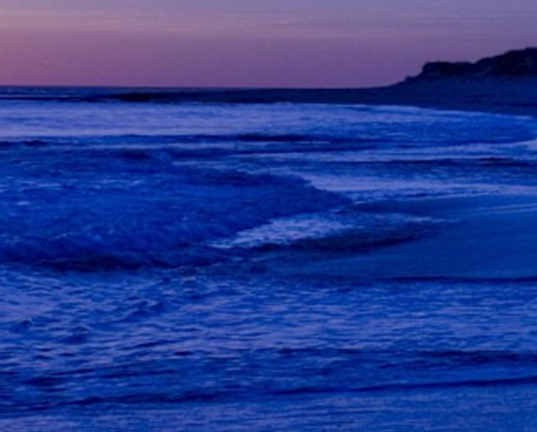
You call me out upon the waters
你在水面之上呼唤我
The great unknown where feet may fail
我或会跌入 那神秘深海
And there I find You in the mystery 在隐秘之处 我寻到你
In oceans deep My faith will stand 在大海深处 我信坚立

Slide 3
And I will call upon Your name
我切切呼唤你名
And keep my eyes above the waves 眼睛不看波涛汹涌
When oceans rise my soul will rest in your embrace
任海水翻腾 我灵在你怀中安息
For I am Yours and You are mine
因我属你 你亦属我

Slide 4
Your grace abounds in deepest waters
深海之中你恩典充满
Your sovereign hand Will be my guide
你大能之手牵引我
Where feet may fail and fear surrounds me
当我会跌倒 恐惧环绕
You've never failed and you won't start now
你从未失败 如今也不会

Slide 5
So I will call upon Your name
我切切呼唤你名
And keep my eyes above the waves
眼睛不看波涛汹涌
When oceans rise My soul will rest in your embrace
当海水翻腾 我灵在你怀中安息
For I am Yours and You are mine
因我属你 你亦属我

Slide 6
Spirit lead me where my trust is without borders
圣灵引领 我信心无限
Let me walk upon the waters
我愿行走在水上
Wherever You would call me
无论你指向何处

Slide 7
Take me deeper than my feet could ever wander
带领我的脚步踏入更深之处
And my faith will be made stronger
我信心更加坚定
In the presence of my Savior
因救主与我同在

Slide 8
I will call upon Your Name
我切切呼唤你名
Keep my eyes above the waves
眼睛不看波涛汹涌
My soul will rest in Your embrace
我灵在你怀中安息
I am Yours and You are mine
因我属你 你也属我

