Slide 1
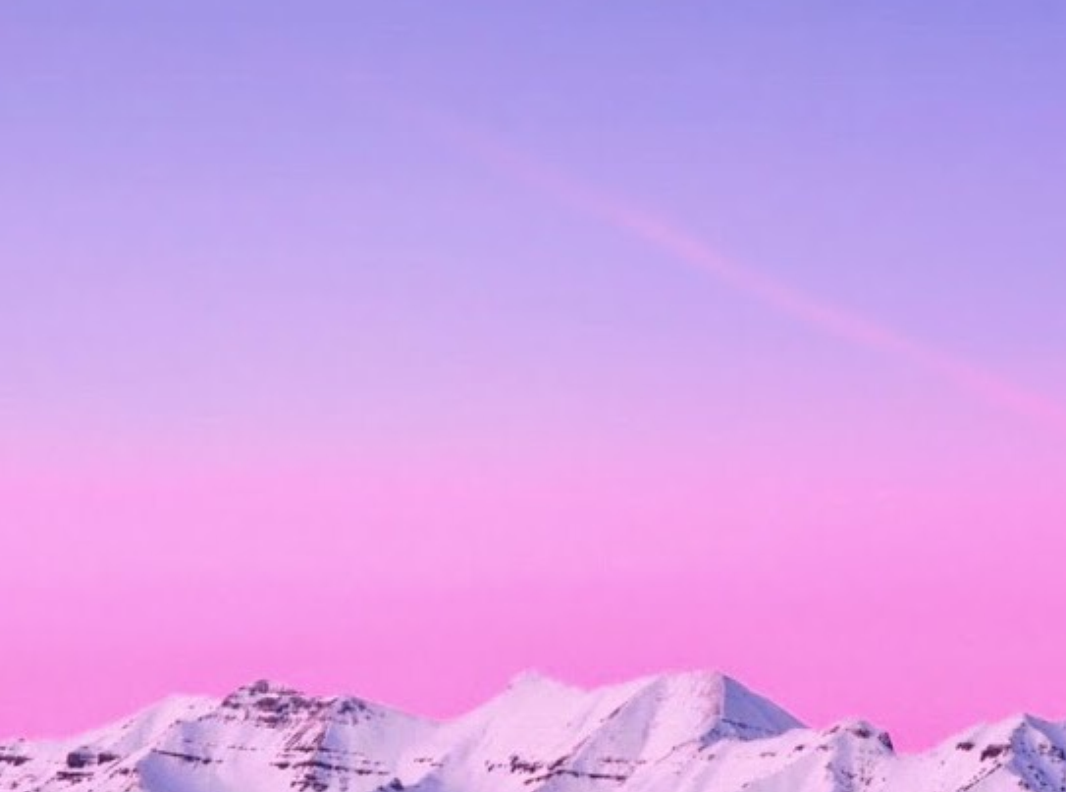
God of Wonders
By Third Day

Slide 2
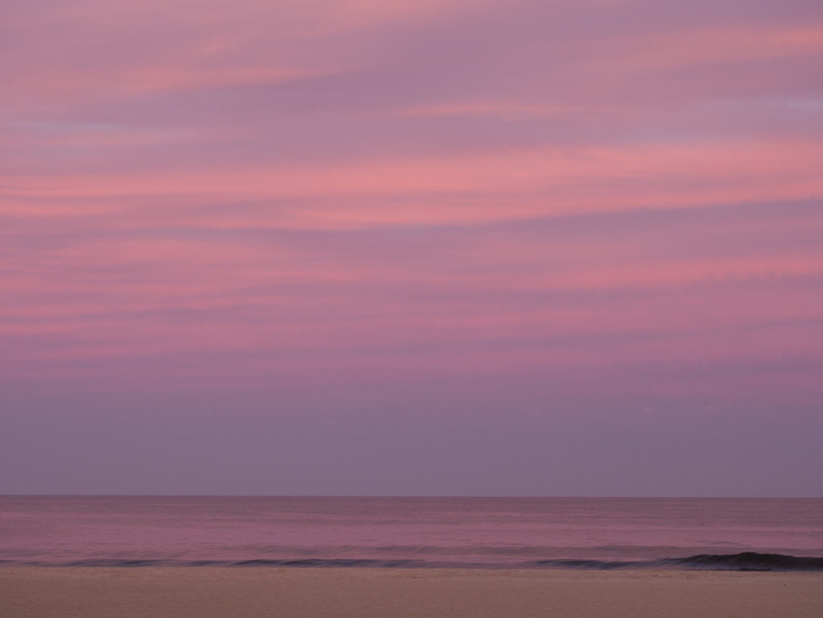
Lord of all creation of water earth and sky
The heavens are Your Tabernacle
Glory to the Lord on high

Slide 3
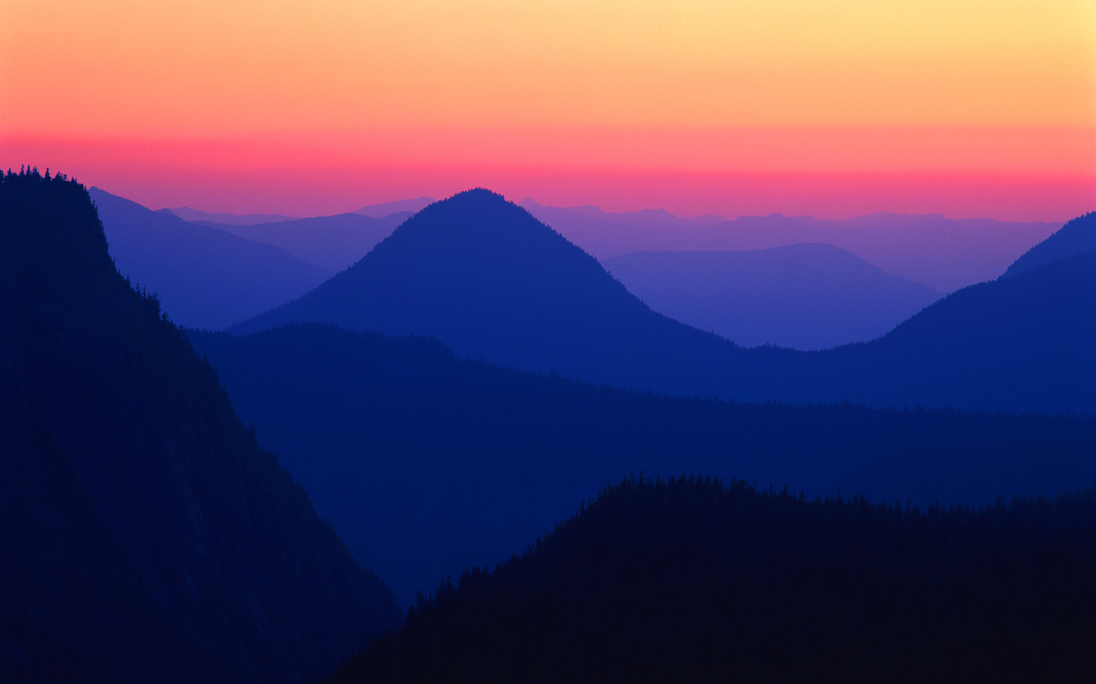
God of wonders beyond our galaxy
You are holy, holy
The universe declares Your Majesty
You are holy, holy

Slide 4
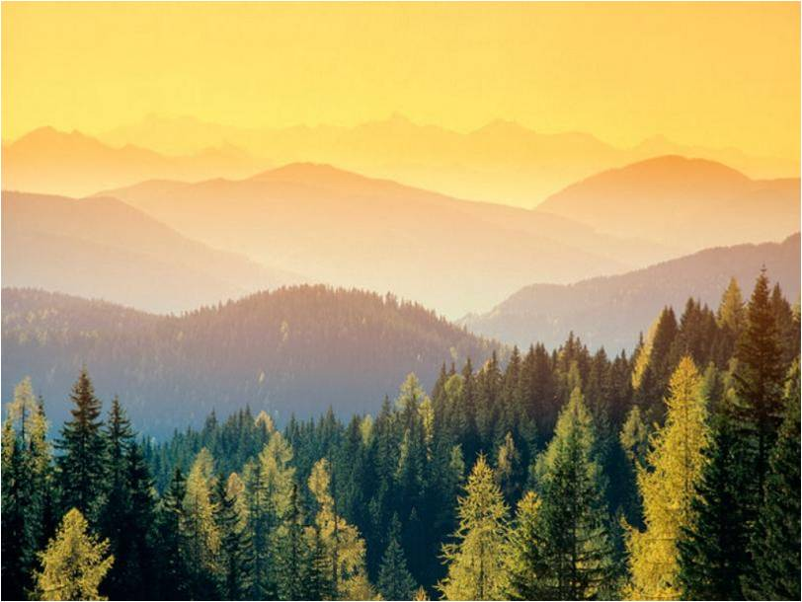
Lord of Heaven and Earth
Lord of Heaven and Earth

Slide 5
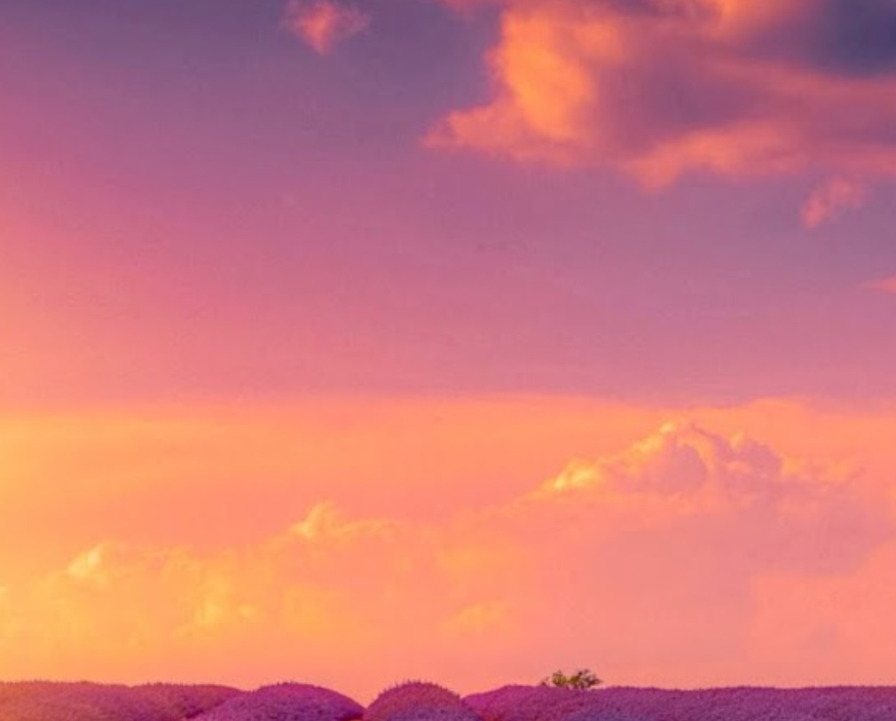
[Instrumental]
Early in the morning
I will celebrate the light
When I stumble in the darkness,
I will call Your Name by night

Slide 6
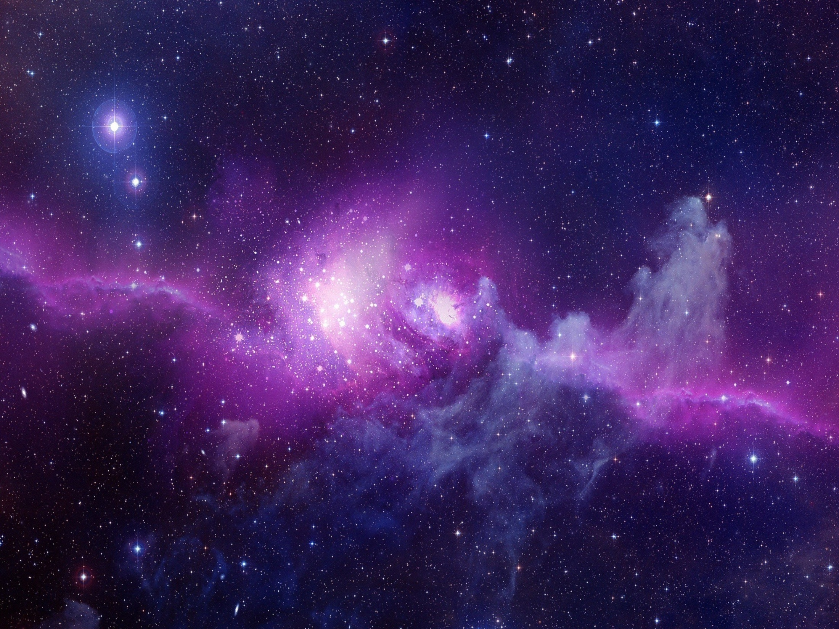
God of wonders beyond our galaxy
You are holy, holy
The universe declares Your Majesty
You are holy, holy

Slide 7

Lord of Heaven and Earth
Lord of Heaven and Earth
Hallelujah, to the Lord of Heaven and Earth [x3]

Slide 8
God of wonders beyond our galaxy
You are holy, holy
Precious Lord, reveal Your heart to me
Father hold me, hold me

Slide 9
The universe declares Your Majesty
You are holy, holy, holy, holy

