Slide 1
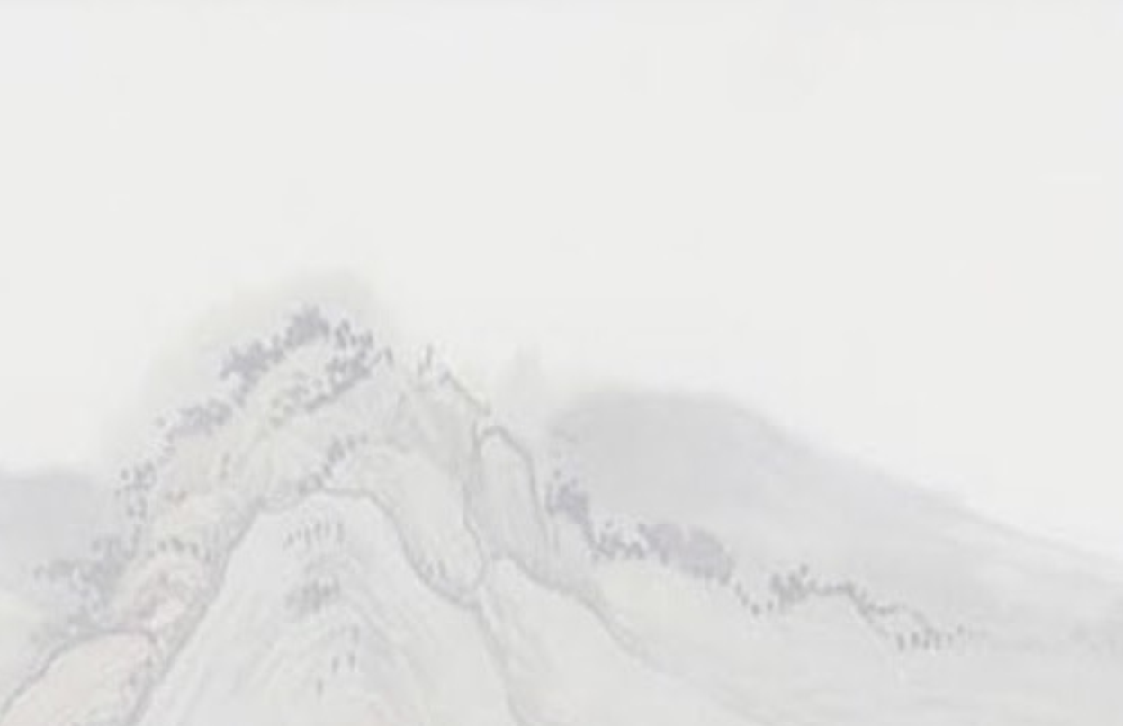
Desert Song

Slide 2
This is my prayer in the desert
When all that's within me feels dry
This is my prayer in my hunger and need
My God is the God who provides

Slide 3
And this is my prayer in the fire
In weakness or trial or pain
There is a faith proved
Of more worth than gold
So refine me, Lord, through the flame

Slide 4
And I will bring praise
I will bring praise
No weapon formed against me shall remain
I will rejoice
I will declare
God is my victory and He is here

Slide 5
And this is my prayer in the battle
When triumph is still on its way
I am a conqueror and co-heir with Christ
So firm on His promise I'll stand

Slide 6
And I will bring praise
I will bring praise
No weapon formed against me shall remain
I will rejoice
I will declare
God is my victory and He is here

Slide 7
All of my life
In every season
You are still God
I have a reason to sing
I have a reason to worship
(X2)

Slide 8
And I will bring praise
I will bring praise
No weapon formed against me shall remain
I will rejoice
I will declare
God is my victory and He is here

Slide 9
This is my prayer in the harvest
When favor and providence flow
I know I'm filled to be emptied again
The seed I've received I will sow
☐

Slide 11
Desert Song

Slide 12
This is my prayer in the desert
When all that's within me feels dry
This is my prayer in my hunger and need
My God is the God who provides

Slide 13
And this is my prayer in the fire
In weakness or trial or pain
There is a faith proved
Of more worth than gold
So refine me, Lord, through the flame

Slide 14
And I will bring praise
I will bring praise
No weapon formed against me shall remain
I will rejoice
I will declare
God is my victory and He is here

Slide 15
And this is my prayer in the battle
When triumph is still on its way
I am a conqueror and co-heir with Christ
So firm on His promise I'll stand

Slide 16
And I will bring praise
I will bring praise
No weapon formed against me shall remain
I will rejoice
I will declare
God is my victory and He is here

Slide 17
All of my life
In every season
You are still God
I have a reason to sing
I have a reason to worship

Slide 18
All of my life
In every season
You are still God
I have a reason to sing
I have a reason to worship

Slide 19
And I will bring praise
I will bring praise
No weapon formed against me shall remain
I will rejoice
I will declare
God is my victory and He is here

Slide 20
This is my prayer in the harvest
When favor and providence flow
I know I'm filled to be emptied again
The seed I've received I will sow

