Slide 1
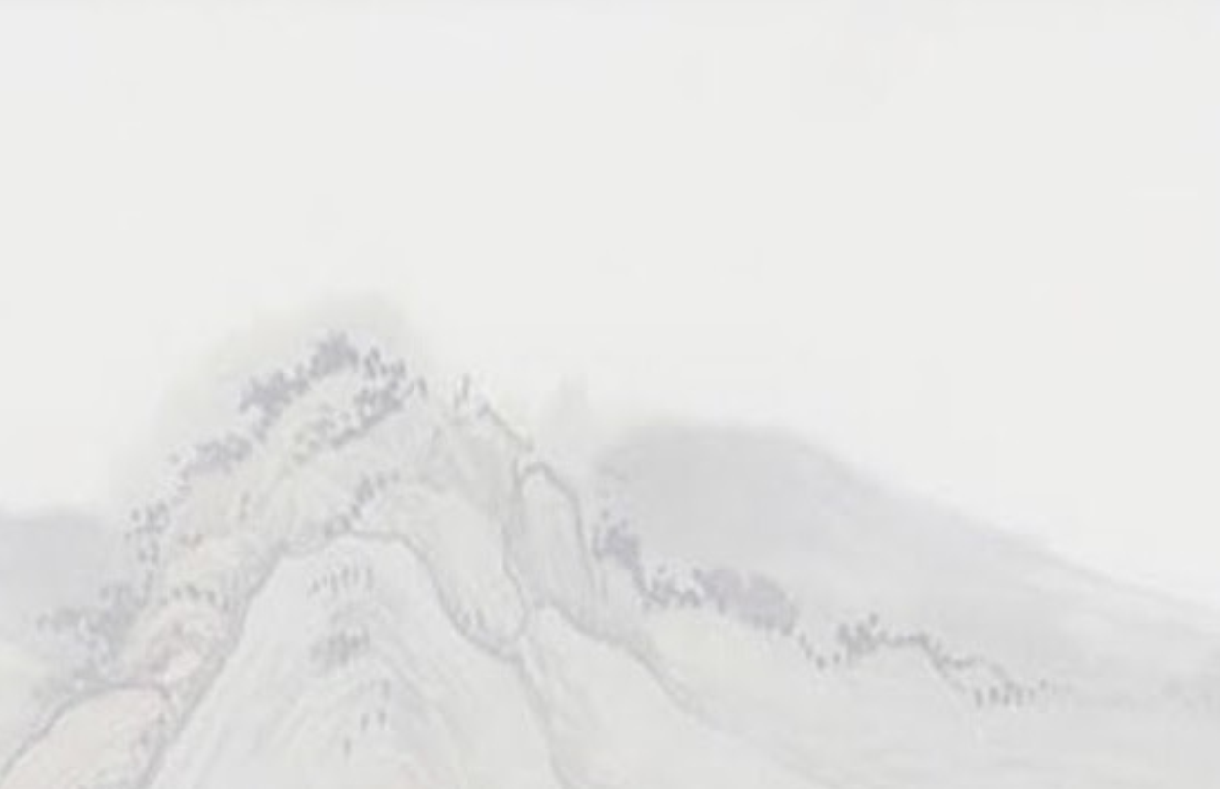
Come Thou Fount

Slide 2
Come thou fount of every blessing
Tune my heart to sing Thy grace
Streams of mercy never ceasing
Call for songs of loudest praise

Slide 3
And teach me some melodious sonnet
Sung by flaming tongues above
I'll praise the Mount I'm fixed upon it
Mount of Thy unchanging love

Slide 4
Here I raise my Ebenezer
Hither by Thy help I come
Oh, and I hope by Thy good pleasure
Safely to arrive at home

Slide 5
Oh Jesus, sought me when a stranger
Wondering from the fold of God
He, to rescue me from danger
Interposed His precious blood

Slide 6
So to grace, how great a debtor
Daily I'm constrained to be
And let Thy goodness like a fetter
Bind my wandering heart to Thee

Slide 7
Prone to wander, Lord, I feel it
Prone to leave the God I love
Here's my heart, Lord, take and seal it
Seal it for Thy courts above

Slide 8
Come thou fount of every blessing
Tune my heart to sing Thy grace
Streams of mercy never ceasing
Call for songs of loudest praise

Slide 9
And teach me some melodious sonnet
Sung by flaming tongues above
I'll praise the Mount I'm fixed upon it
Mount of Thy unchanging love
☐

Slide 10
Come Thou Fount

Slide 11
Come, Thou Fount of every blessing
Tune my heart to sing Thy grace
Streams of mercy, never ceasing
Call for songs of loudest praise

Slide 12
Teach me some melodious sonnet
Sung by flaming tongues above
Praise the mount, I’m fixed upon it
Mount of Thy unchanging love

Slide 13
Here I raise my Ebenezer
Here there by Thy great help I’ve come
And I hope, by Thy good pleasure
Safely to arrive at home

Slide 14
Jesus sought me when a stranger
Wandering from the fold of God
He, to rescue me from danger
Interposed His precious blood

Slide 15
O to grace how great a debtor
Daily I’m constrained to be
Let that grace now, like a fetter
Bind my wandering heart to Thee

Slide 16
Prone to wander, Lord, I feel it
Prone to leave the God I love
Here’s my heart, O take and seal it
Seal it for Thy courts above

Slide 17
Come, Thou Fount of every blessing
Tune my heart to sing Thy grace
Streams of mercy, never ceasing
Call for songs of loudest praise

Slide 18
Teach me some melodious sonnet
Sung by flaming tongues above
Praise the mount, I’m fixed upon it
Mount of Thy unchanging love

