Slide 1

Because He Lives
因他活着

Slide 2
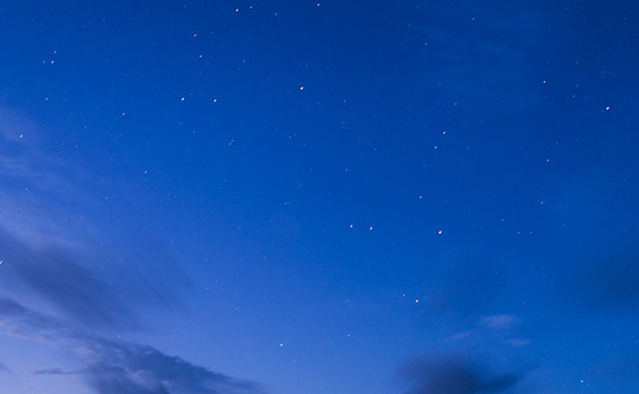
(Verse 1)
God sent His Son
they called Him Jesus
He came to love, heal and forgive
神子耶稣，降生到世界，
医治拯救世上罪人；

Slide 3
(Verse 1 - Cont’d)
He bled and died to buy my pardon
An empty grave is there to prove
My Savior lives
为赎我罪主钉死十架，
空的坟墓却证明
救主仍活着。

Slide 4
(Chorus)
Because He lives I can face tomorrow
Because He lives all fear is gone
Because I know He holds the future
And life is worth the living
Just because He lives
因祂活着，我能面对明天，
因祂活着，不再惧怕；
我深知道祂掌握明天，
生命充满了希望，只因祂活着。

Slide 5
(Verse 2)
How sweet to hold our newborn baby
And feel the pride and joy he gives
新生婴孩，被抱在怀里，
何等安祥令你欣喜；

Slide 6
(Verse 2 - Cont’d)
But greater still the calm assurance
This child can face uncertain days
Because Christ lives
但你确信这幼小生命，
却能面对着明天
因基督活着。

Slide 7
(Chorus)
Because He lives I can face tomorrow
Because He lives all fear is gone
Because I know He holds the future
And life is worth the living
Just because He lives
因祂活着，我能面对明天，
因祂活着，不再惧怕；
我深知道祂掌握明天，
生命充满了希望，只因祂活着。

Slide 8
(Verse 3)
And then one day I'll cross that river
I'll fight life's final war with pain
当我走完，人生的路程，
面对死亡痛苦争战；

Slide 9
(Verse 3 - Cont’d)
And then as death gives way to vict'ry
I'll see the lights of glory
And I'll know He reigns
救主为我战胜了死权，
在荣光中我见
救主祂是活着。

Slide 10
(Chorus)
Because He lives I can face tomorrow
Because He lives all fear is gone
Because I know He holds the future
And life is worth the living
Just because He lives
因祂活着，我能面对明天，
因祂活着，不再惧怕；
我深知道祂掌握明天，
生命充满了希望，只因祂活着。

Slide 11
(Chorus - repeat)
Because He lives I can face tomorrow
Because He lives all fear is gone
Because I know He holds the future
And life is worth the living
Just because He lives
因祂活着，我能面对明天，
因祂活着，不再惧怕；
我深知道祂掌握明天，
生命充满了希望，只因祂活着。

