Slide 1
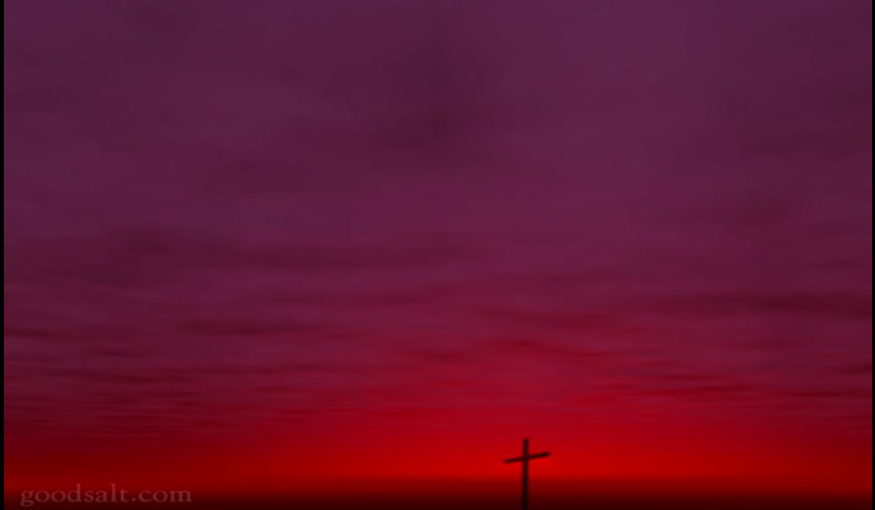
Above all

Slide 2
Above all powers
Above all kings
Above all nature and all created things
Verse1-1

Slide 3
Above all wisdom and all the ways of man
You were here before the world began
Verse1-2

Slide 4
Crucified，Laid behind the stone
You lived to die，Rejected and alone
Like a rose trampled on the ground
You took the fall，And thought of me
Above all
Chorus 1

Slide 5
Above all powers
Above all kings
Above all nature and all created things
Verse2-1

Slide 6
Above all wisdom and all the ways of man
You were here before the world began
Verse2-2

Slide 7
Crucified，Laid behind the stone
You lived to die，Rejected and alone
Like a rose trampled on the ground
You took the fall，And thought of me
Above all
Chorus 2

Slide 8
Crucified，Laid behind the stone
You lived to die，Rejected and alone
Like a rose trampled on the ground
You took the fall，And thought of me
Above all
Chorus repeat 1

Slide 9
Like a rose trampled on the ground
You took the fall，And thought of me
Above all
Chorus repeat end

Slide 10
Above All

Slide 11
Above all powers, above all kings
Above all nature, and all created things
Above all wisdom, and all the ways of man
You were here before the world began

Slide 12
Above all kingdoms, above all thrones
Above all wonders the world has ever known
Above all wealth, and treasures of the earth
There’s no way to measure what you’re worth

Slide 13
Crucified, laid behind a stone
You lived to die, rejected and alone
Like a rose, trampled on the ground
You took the fall, and thought of me
Above all

Slide 14
Above all powers, above all kings
Above all nature, and all created things
Above all wisdom, and all the ways of man
You were before the world began

Slide 15
Above all kingdoms, above all thrones
Above all wonders the world has ever known
Above all wealth, and treasures of the earth
There’s no way to measure what you’re worth

Slide 16
Crucified, laid behind a stone
You lived to die, rejected and alone
Like a rose, trampled on the ground
You took the fall, and thought of me
Above all [x2]

Slide 17
Like a rose, trampled on the ground
You took the fall, and thought of me
Above all

