Slide 1
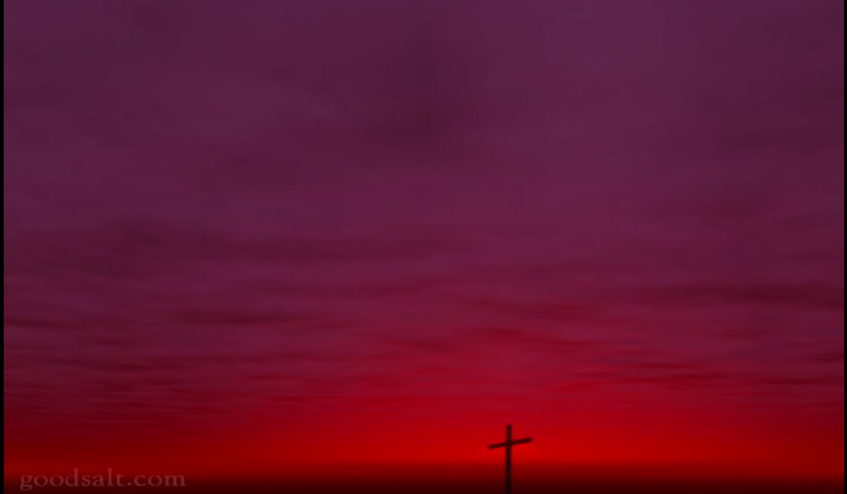
Above all
超乎一切

Slide 2
Above all powers
超乎众权能
Above all kings
超乎众王
Above all nature
超乎众受造 and all created things
和宇宙众万物
Verse1-1

Slide 3
Above all wisdom
超乎众智慧 and all the ways of man
和众人的道路
You were here
是你创造 before the world began
天地和万物
Verse1-2

Slide 4
Crucified，Laid behind the stone
钉十架，埋葬在石洞
You lived to die，Rejected and alone
祢捨生命，被拒绝和孤单
Like a rose trampled on the ground
像玫瑰，遭践踏在地
You took the fall，And thought of me
胜过死亡，祢顾念我
Above all
超乎一切
Chorus 1

Slide 5
Above all powers
超乎众权能
Above all kings
超乎众王
Above all nature
超乎众受造 and all created things
和宇宙众万物
Verse2-1

Slide 6
Above all wisdom
超乎众智慧 and all the ways of man
和众人的道路
You were here
是你创造 before the world began
天地和万物
Verse2-2

Slide 7
Crucified，Laid behind the stone
钉十架，埋葬在石洞
You lived to die，Rejected and alone
祢捨生命，被拒绝和孤单
Like a rose trampled on the ground
像玫瑰，遭践踏在地
You took the fall，And thought of me
胜过死亡，祢顾念我
Above all
超乎一切
Chorus 2

Slide 8
Crucified，Laid behind the stone
钉十架，埋葬在石洞
You lived to die，Rejected and alone
祢捨生命，被拒绝和孤单
Like a rose trampled on the ground
像玫瑰，遭践踏在地
You took the fall，And thought of me
胜过死亡，祢顾念我
Above all
超乎一切
Chorus repeat 1

Slide 9
Like a rose trampled on the ground
像玫瑰，遭践踏在地
You took the fall，And thought of me
胜过死亡，祢顾念我
Above all
超乎一切
Chorus repeat end

